Slide 1
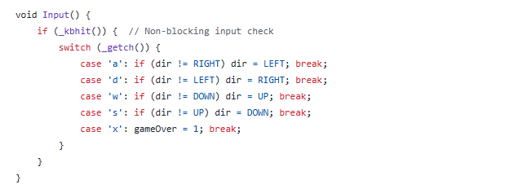
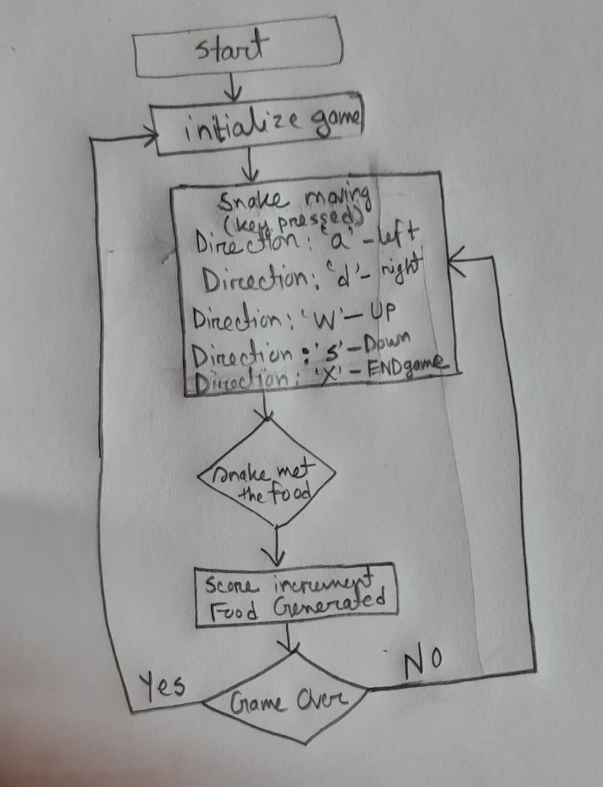
Input handling
Key Points:
Non-blocking input detection using _kbhit().
Controls:
‘a' → Left (unless moving Right)
‘d' → Right (unless moving Left)
‘w' → Up (unless moving Down)
‘s' → Down (unless moving Up)
'X' → End game
Instant exit with ‘X’.
Uses conio.h for real-time input polling.

